Slide 1
Welcome to Parent Night!
Please take an information packet, take a seat,
fill out the PG Permission form, and
fill out the Background Check form.
Notes:
This presentation would be used during curriculum night (9/24/2009). I would have this slide projected on my SMART Board as parents arrive. It welcomes them and tells them some tasks to accomplish. That way we can get all of the “busy work” done before the presentation. When parents have settled in, I will start the presentation by going through each slide, elaborating on key points, and asking for questions. I hope that parents feel welcome so they will feel free to contact me throughout the school year.
In my school, there are many parents who are not native-English speakers. Some parents are not confident and feel uncomfortable in a school setting because it is very different than what they are accustomed to (i.e., parents from Japan, China, Korea, Vietnam). I want to create an atmosphere that welcomes all parents and children in the most warm way possible. I strive to create relationships with children and their parents so they can come to me with any questions or concerns in the future. I believe that building trust is key to successful home/school communication.
I hope that the parents will feel as welcome as their children. At this point, their children will be in school for a few weeks. We will establish routines and create a community of learners. I hope that this presentation will answer any questions that parents may have about 2nd grade procedures and curriculum. Additionally, it will introduce them to learning with a SMART Board and sound field system.
You will notice that my presentation has a lot of places for pictures (green rectangles with no images yet). I will take actual pictures of objects and students in my classroom to add them to the presentation. Since most of the parents in my classroom are not native-English speakers, pictures and diagrams are necessary for their understanding. A simple word like “cupcake” is not understood by most parents, but with the aid of a visual, they can understand.

Slide 2
Meet the Teacher
Schools
Michigan State University
Spring Arbor University
Teaching
4th & 2nd grade at Red Cedar
Home Life
Married & 3 boys
Interests
3rd grade in El Lago, Texas
4th grade internship in Haslett
Notes:
Michigan State: BA in English
Spring Arbor: Elementary Education Teaching Certificate
Back to MSU: Masters in Educational Technology
Home Life: Married to Brad, 2 boys (Kaleb-7, Collin-3)
Interests: Reading, traveling (going up north), anything artsy-craftsy, learning new things about the computer, spending time with family and friends.
(I got the Spartan logo from the MSU University Relations website. It did not give specifics on when you could use it, but it had downloads. Please let me know if this is not ok, and I will change it.)
(I got permission from Christian Palasty, Technology Director for East Lansing Public Schools, to use the Red Cedar logo.)

Slide 3
Meet the Student Teacher
School
Michigan State University
Teaching
Sherwood Ridge Public School, Kellyville, NSW, Australia (K, 4/5, support classes)
4th grade internship at Red Cedar
Homelife
Spartan Marching Band
Interests

Slide 4
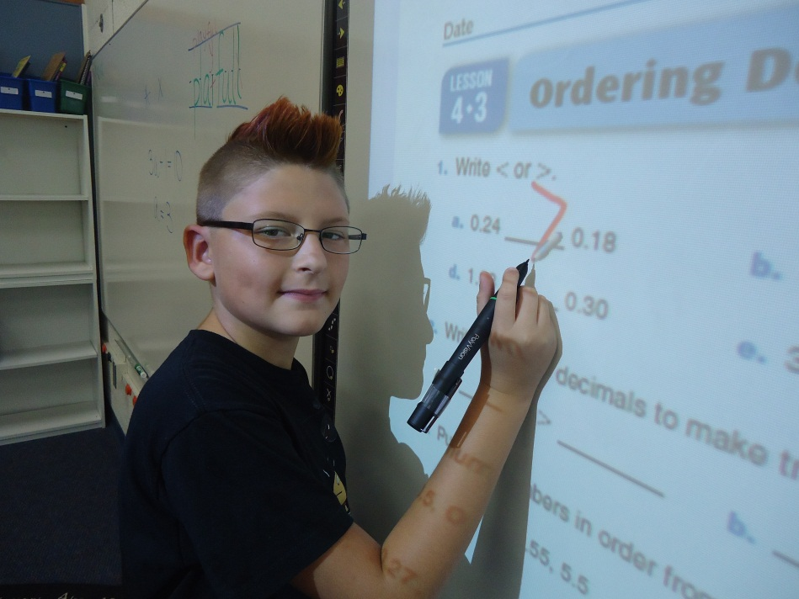
Goals for 4th Grade
Love learning!
Feel safe and happy
Take appropriate risks
Diversity
Respect
Grow to full potential
Notes:
Second grade is an important year of transition. Children are becoming more independent and able to make decisions without constant teacher guidance. They still need a lot of reassurance and instruction, but they are able to manage their time more efficiently.
We hope to help children:
Continue to love learning!
Feel safe and happy in school.
Learn to take appropriate risks academically and socially.
Appreciate their diverse abilities and talents.
Remember to treat classmates, teachers, and the school with respect.
Grow to their full potential as learners and as children.
We will achieve these goals through:
Small group and whole group instruction
Individual tutoring
Stories
Music
Games
Learning Centers
Theatre
Creative movement
Technology

Slide 5
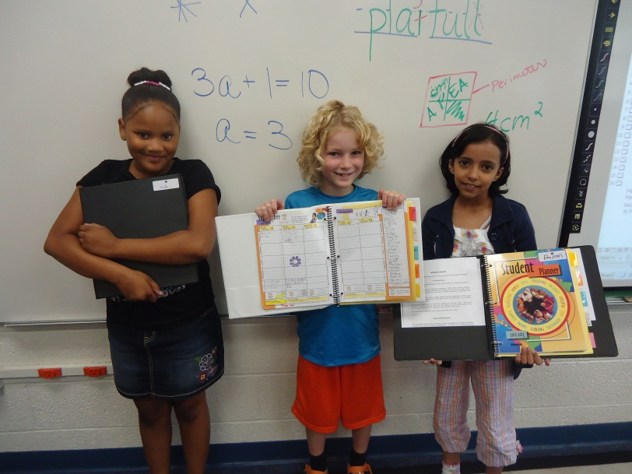
Procedures
Binder & Planner
Back and forth everyday
Homework
Establish routine
Please sign BOTH planner and homework
Notes:
Your child will bring home 2 different folders during the week (show folders). Explain difference. You can send any notes to teacher in Blue Folder.
Homework
The most important thing your child can do at home is READ! Please help your child to get in a routine of reading for 20 minutes each night. In addition, your child soon will be bringing home a blue folder each night with math homework. This homework will be given each night to compliment the math lesson done during the school day. It is ALWAYS due the next day. If there is other homework, you will find it in that same blue folder. If you think your child needs more work at home, please visit the spelling webpage to practice spelling words and READ more each night.

Slide 6
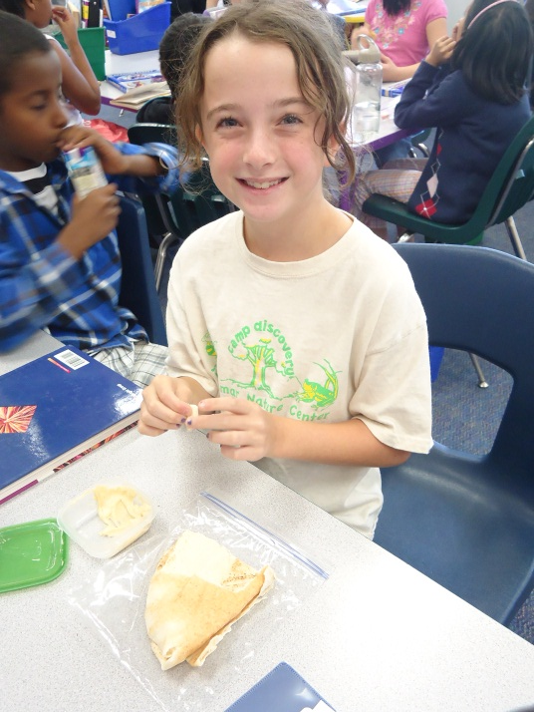
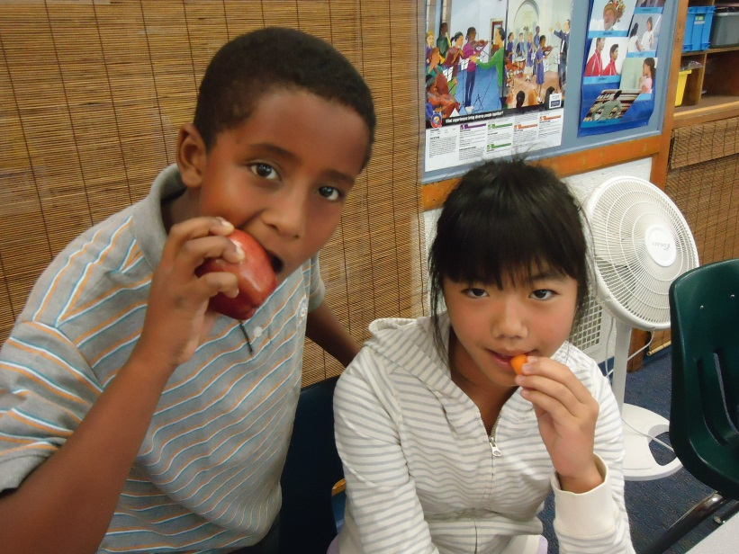
Snacks
Healthy – YES!
Fruit
Vegetables
Granola Bars
Pretzels
Yogurt
Crackers
Cheese
Notes:
In 2nd grade, we will be learning about how to eat a healthy diet. Therefore, I would like to reinforce this concept during our daily snack. Students should be bringing food that is low in sugar and fat. Examples include: fruit, veggies, granola bars, pretzels, yogurt, crackers, and cheese. Snack is not meant to replace a meal, so please do not send in a lot of food. It meant to be an energy boost in the mid-morning to get your child to lunch.
Do NOT send anything with sugar listed as one of the first 3 ingredients. Examples include cookies, cakes, sugary cereal, chocolate. Please also do not send chips or anything that is full of fat.
(I will have examples of healthy foods to show)
Please make sure to pack a spoon if your child needs one.
We do not participate in the snack program in 2nd grade, so you are responsible for sending snack for your child each day. We eat lunch at 12:45, so the morning can get long. If each family sends in a box of individually wrapped healthy snacks, your child can get 1 snack per month from the class.

Slide 7
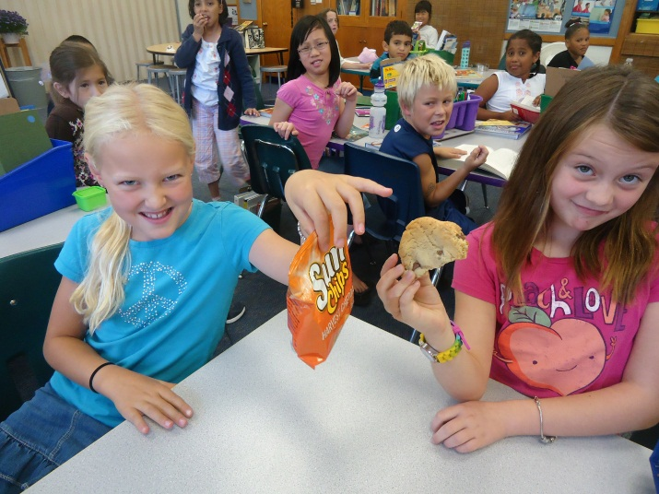
Snacks
Unhealthy – NO!
Messy – NO!
Sugar
Cookies
Cakes
Chocolate
Pudding
Sugary Cereal
Fatty Foods
Chips
Yogurt in a tube
Gogurt & Crush Cups
Unpeeled oranges

Slide 8
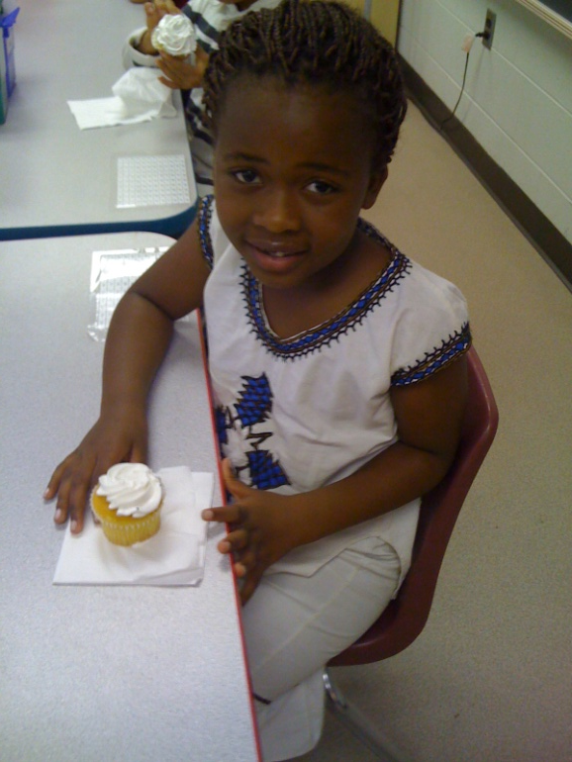
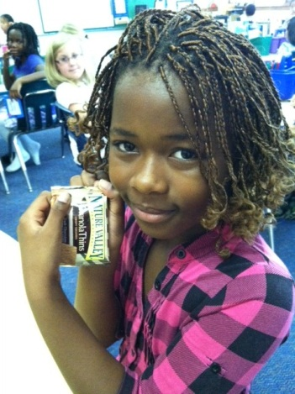
Birthdays
Send a note in advance
Individual treat
Cupcakes
Individually wrapped ice cream treats
Cookies
Notes:
Everyone loves to celebrate in school! Please send me a note in advance of the big day to tell me that you would like to send in a treat. Extra time will need to be planned, so knowing in advance helps a lot.
If you send a sweet treat, please remember that it must be cupcakes, individual cookies, or individual ice cream treats. Cakes that need to be cut apart or ice cream that needs to be scooped are very inconvenient. Please also remember to send napkins.
Summer birthdays are celebrated the last week of school.
Some families prefer to send a new book for the class in lieu of an edible treat. We always love to increase our book collection!

Slide 9
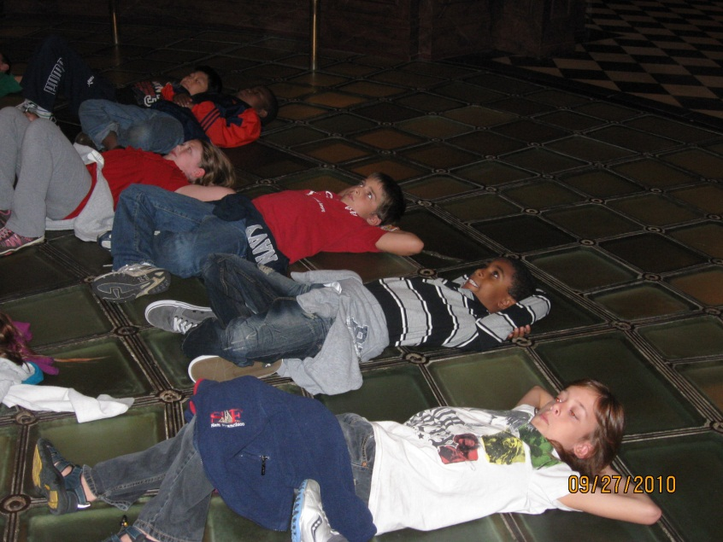
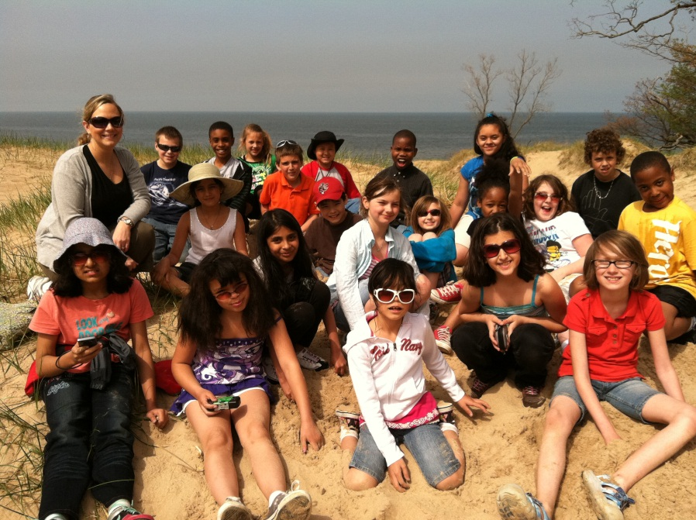
Field Trips
Movie Theater
Plays
Historical Museum
State Capitol
Planetarium
Sand Dunes
Aquatic Center
Notes:
(The photo will be replaced with a picture of Potter Park Zoo or the Turner-Dodge House after I take the pictures)
We will go on a variety of curriculum-based field trips, and a few just-for-fun trips, throughout the year. I will keep you informed on field trips throughout the school year. Please keep your eyes on the newsletters that are sent home bi-weekly. They will have information and will ask for chaperones to join us. If you are able to help out, I ask that you let me know as soon as possible. There are some field trips that require many chaperones, and some that limit the amount of people that can attend.

Slide 10
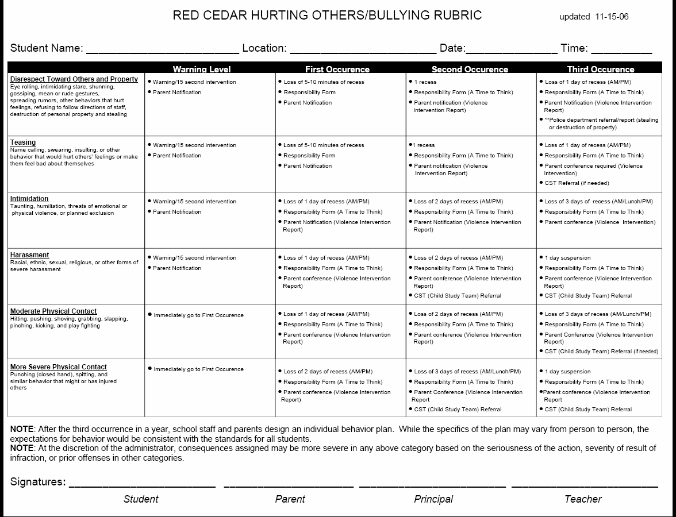
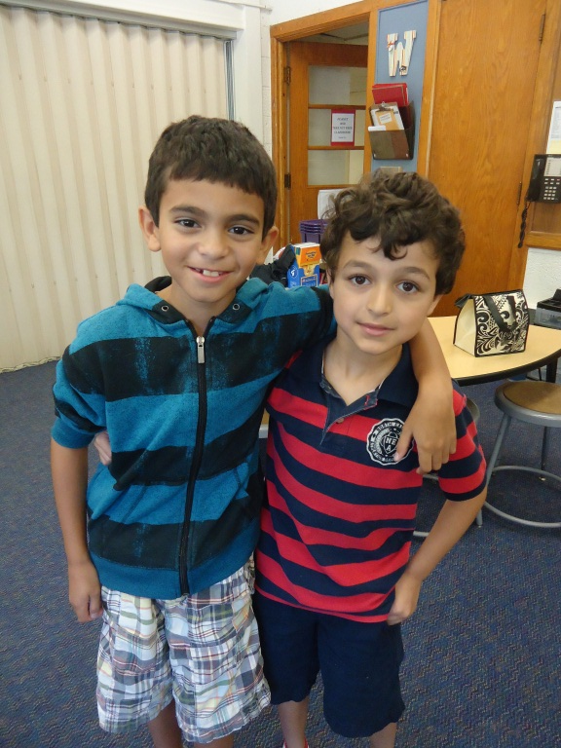
Bullying Rubric
Notes:
Not only will your child learn academics in school, he/she will also learn how to be a good citizen. Red Cedar has an “Anti-Bullying Rubric” that is used school-wide. That way, students who do not make good choices will have consequences for their actions (explain rubric and how powerful it can be). Notice that “contacting parents” is written very often. We believe in maintaining strong home/school communication, so you will be made aware if something happens with your child.
(The actual Bullying Rubric will be inserted. I do not have access to it this summer.)

Slide 11
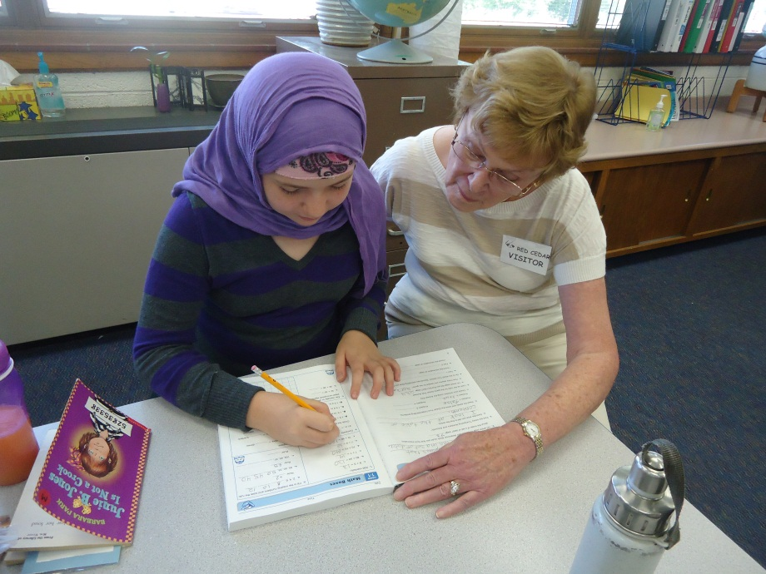
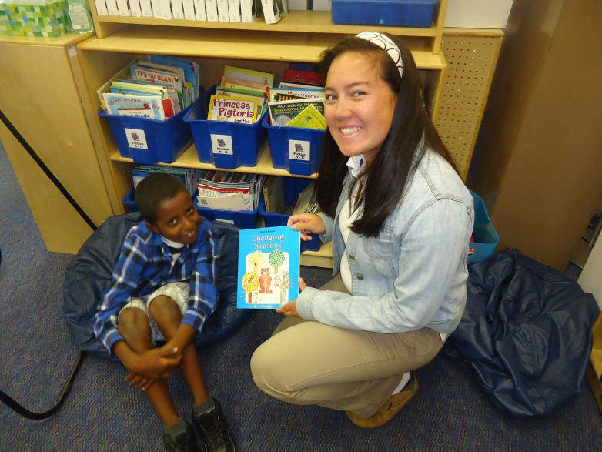
Volunteers
MSU & CMU students
Community Members
Family Members
Please no younger siblings
Background Check
Notes:
Since we are right across the street from MSU’s campus, we have a lot of volunteers who will be working with your children. I try to have volunteers come in during Writing and Math time so more children have 1-on-1 support.
We will also need volunteers for classroom parties and field trips.
If you are interested in volunteering in the classroom, please contact me ahead of time.
(Picture would be of Grandma Carol or MSU/CMU volunteers) ☺

Slide 12
Questions about classroom or school procedures?
?
Notes:
Question and answer period.

Slide 13
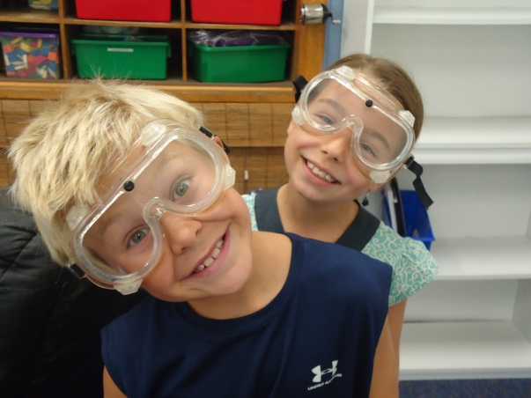
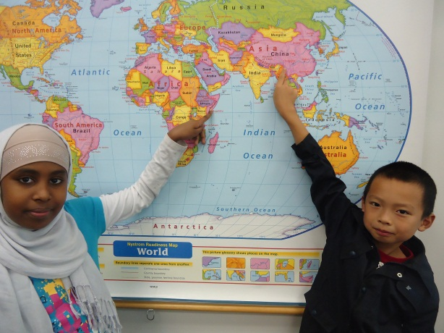
Academics
Science
Social Studies
Changing Earth
Energy Transfer
Matter
Ecology
Health
Civics & Government
Economics
Geography
Current Events
Notes:
Science and Social Studies will not be taught at the same time. Science may be taught one month, then Social Studies the next. That way we can delve deeper into the subject areas without worrying about time constraints.

Slide 14
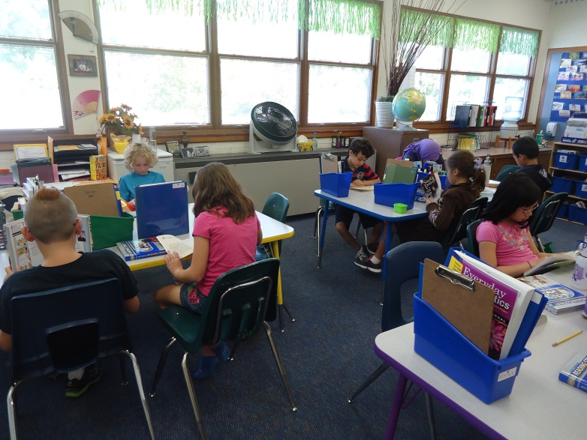
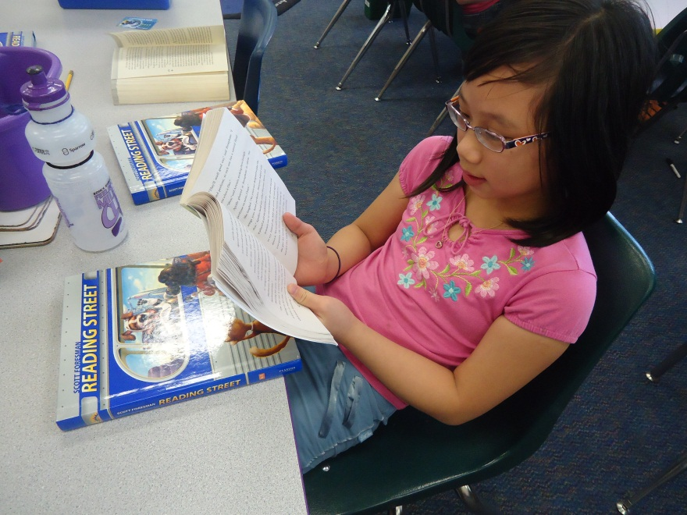
Language Arts
Reading
Reading Street
Daily 5
Writing
Lucy Calkins
Writers Workshop
Spelling
Reading Street
High Frequency Words
Notes:
Explain that children will be spending much more time in 2nd grade independently reading than they have previously. We will build stamina. They will gain schema and learn to use the comprehension and decoding skills taught in Readers Workshop and Guided Reading. Part of their homework every night is to read for 20 minutes. This will help them with all subjects in school, so I would love it if we could work as a team to encourage the children to READ, READ, READ!
Writing will occur across the curriculum (problem solving in Math, Science Journals, social studies responses and projects).
Spelling is high frequency words that are used in context. Students are expected to spell these words correctly in daily writing as well as in Word Reviews.
(This is a picture of my classroom in TX. I would take a new picture of my classroom at Red Cedar.)

Slide 15
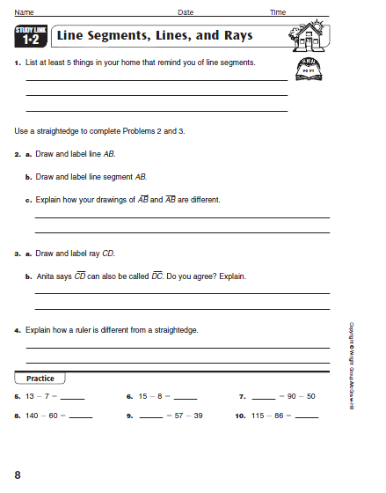
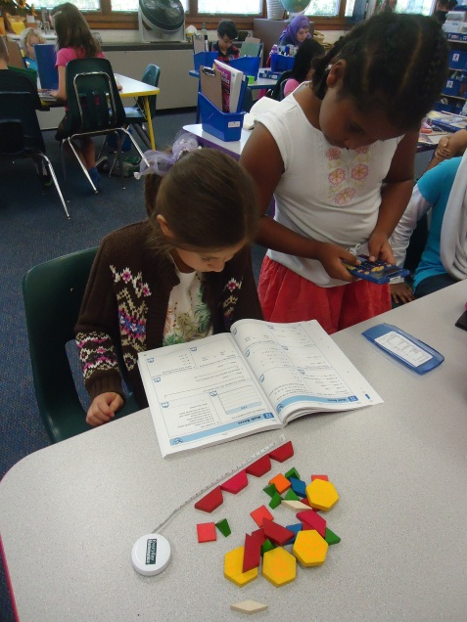
Math
Everyday Mathematics
Numbers & Numeration
Operations & Computation
Data & Chance
Measurement &
Reference Frames
Geometry
Patterns, Functions,
& Algebra
Homework Procedures
Basic Facts!!!
Notes:
We use Everyday Mathematics, and your child will be exposed to math 60-90 minutes per day. The math program may look different than anything you have seen before (explain about Journal, Math Boxes, games, etc).
This may be the first year your child takes a math test. I send home Test Reviews before the test and we go over them in class. You are encouraged to help your child with these reviews and all homework that is sent home. The more a concept is reviewed, the better it is retained.
Your child will have math homework each night. It will come home in the blue folder. Please set aside a special place and time that your child can complete this (it does not have to be right before bed). It may take 5-20 minutes, depending on how your child understands the concepts taught. All homework is a review of what was taught in class that day. Also, at the beginning of each unit, you will receive a Family Letter. Some concepts will be unfamiliar, so this letter explains how to complete the homework.

Slide 16
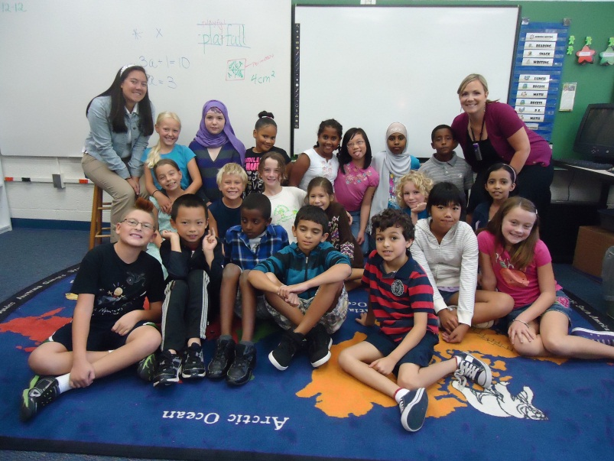
Contact
Mary Wever 4th Grade Teacher
Rachelle Galang
4th Grade Student Teacher
Email: wever_mk@elps.us
galang_r@elps.us
Phone: (517) 333-5060
Send notes in daily folder.
Class Photo
Notes:
I

Slide 17
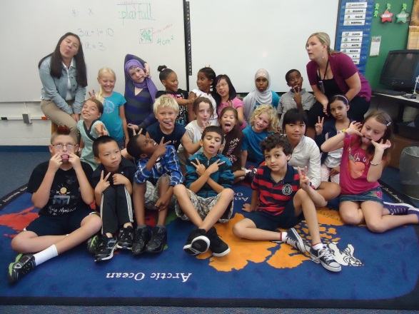
Thank you for coming! We look forward to working with you and your child this year!
Please hand PG Permission Slips &
Background Check Forms to a teacher.
Notes:
Ask for more questions.

